Slide 1
Lecture 3 Linear Programming I

Slide 2
Agenda
Revisit McDonald’s diet problem
Formulation
Excel solution
Product Mix problem
Formulation
Excel solution
Linear Programming: terminology

Slide 3

Revisit McDonald’s Diet Problem
You want your diet to meet some nutritional standards.
According to your daily diet plan you need to have
at least 100 percent of the U.S. RDA of vitamin C and calcium;
at least 55 grams of protein; and at most 2000 calories.
You are wondering if this can be accomplished by eating at McDonald’s.
Can you design a least-cost McDonald’s daily meal plan that meets your
daily nutritious standard?

Slide 4
McDonald’s Diet Problem Formulation
Data for the McDonald’s Diet Problem
1. What must be decided?
2. What measure should we use to compare alternative sets of decisions?
3. What restrictions limit our choices?
Diet Plan
x1 = # of hamburgers x4 = # of Garden Salads
x2 = # of Big Macs x5 = # of Baked Apple Pies
x3 = # of Chicken McNuggets
Money Spent on McDonald’s Diet
Calories obtained ≤ 2000
Protein obtained ≥ 55 gram
Vitamin C obtained ≥ 100% of U.S. RDA
Calcium obtained ≥ 100% of U.S. RDA

Slide 5
McDonald’s Diet Problem Formulation
4. Formulate the objective function:
MIN 0.69x₁+ 1.99x₂+ 1.99x₃+ 2.05x₄+ 0.79x₅
5. Formulate the constraints:
Calories: 260x₁+ 560x₂ + 250x₃+ 35x₄+ 260x₅ ≤ 2000
Protein (in g):13x₁ +25x₂ + 15x₃ + 2x₄ + 3x₅ ≥ 55
Vit. C (in %): 2x₁ + 2x₂ + 2x₃ + 40x₄+40x₅ ≥ 100
Calcium (in %):15x₁+ 25x₂ + 2x₃ + 4x₄+ 2x₅ ≥ 100
6. Do we need non-negativity constraints?
x_{i} ≥ 0 , i=1,2,3,4,5
7. Write down the total problem formulation:
MIN 0.69x₁+ 1.99x₂+ 1.99x₃+ 2.05x₄+ 0.79x₅
s.t.
Calories: 260x₁+ 560x₂ + 250x₃+ 35x₄+ 260x₅ ≤ 2000
Protein (in g):13x₁ +25x₂ + 15x₃ + 2x₄ + 3x₅ ≥ 55
Vit. C (in %): 2x₁ + 2x₂ + 2x₃ + 40x₄+40x₅ ≥ 100
Calcium (in %):15x₁+ 25x₂ + 2x₃ + 4x₄+ 2x₅ ≥ 100
x_{i} ≥0, i=1,2,3,4,5

Slide 6
A Linear Program (LP)
We just formulated the McDonald’s diet problem as a linear program
If you’ve taken a course in calculus, you have probably encountered optimization problems that you solve using differentiation
A linear program is an optimization problem that is solved by methods other than differentiation
The word “linear” means that relationships are linear
The word “program” means plan or schedule
A staggering diversity of problems can be posed as linear programs: they are routinely used in industry and government for planning and managing day-to-day operations
Linear programs are important!

Slide 7
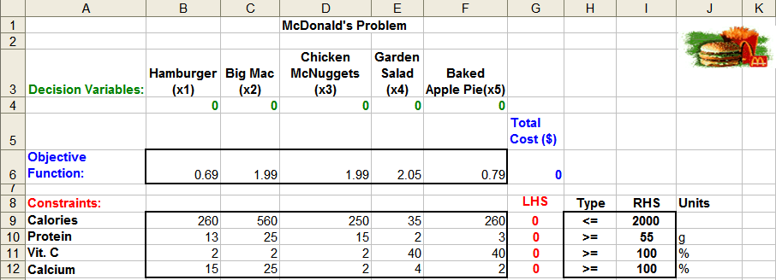
McDonald’s Problem – Spreadsheet Setup
Decision variable cells
B4:F4
Objective function cell
G6
Constraint cells
G9:G12
Enter parameters in variable cells B6:F6, B9:F12, I9:I12
Decision variable cells: fill zeros as initial values in cells B4:F4
Objective function cell:
G6 = SUMPRODUCT(B4:F4,B6:F6)
Constraint cells:
G9 = SUMPRODUCT($B$4:$F$4, B9:F9)
Copied to G10:G12

Slide 8
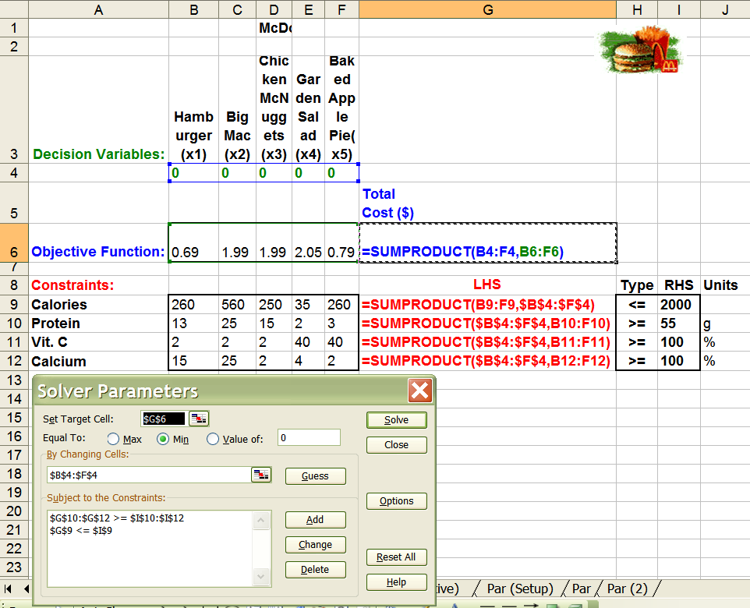
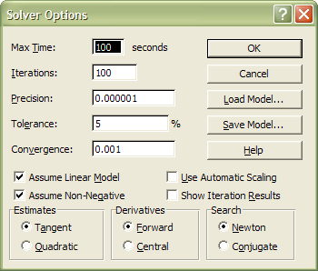
McDonald’s Problem – Use of Solver [Office 07]
Data tab -> Analysis
-> Solver
Objective: MIN G6
Variables: B4:F4
Constraints: G9 <= I9
G10:G12>= I10:I12
Options: Assume Linear Model
Assume Non-Negative

Slide 9
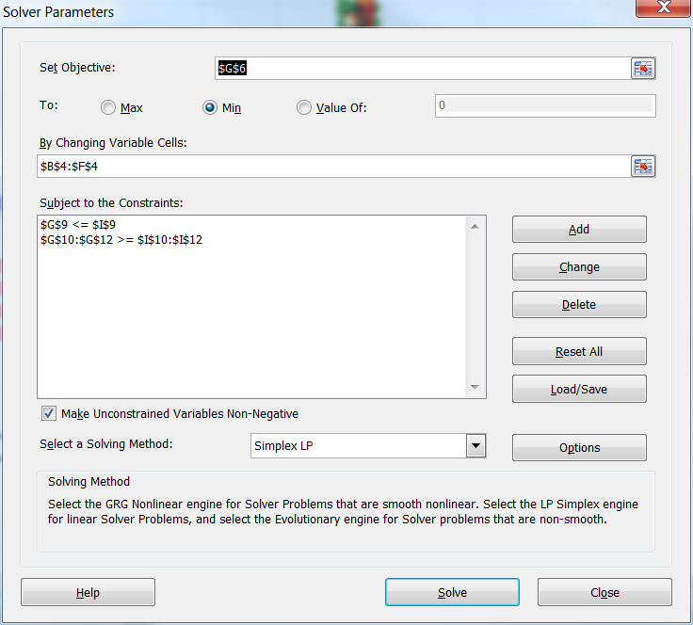
McDonald’s Problem – Use of Solver [Office 10]

Slide 10
Answer Report-Binding & Slack Constraints
Optimal objective
function value
Optimal decision
variable values
(or Optimal
Solution)
Constraints:
Binding means LHS=RHS, implies Slack =0
Not Binding means LHS>(<)RHS, implies Slack>(<)0

Slide 11
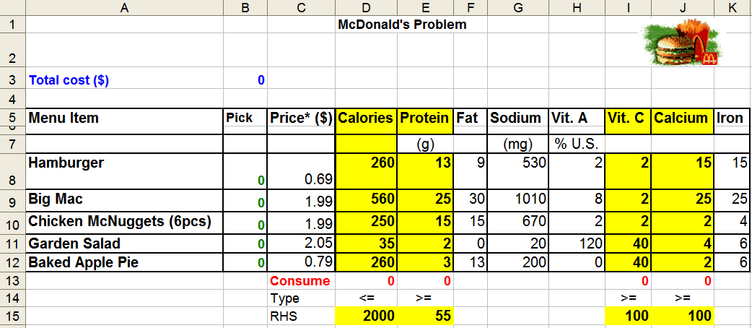
Alternative Spreadsheet Setup
Build model upon the existing data structure
Decision variable cells
B8:B12
Objective function cell
B3
Constraint cells
D13:E13, I13:J13
Decision variable cells: fill zeros as initial values in cells B8:B12
Objective function cell:
B3 = SUMPRODUCT( C8:C12,$B$8:$B$12)
Constraint cells:
D13 = SUMPRODUCT(D8:D12,$B$8:$B$12)
Copied to E13, I13:J13
Objective: MIN B3
Variables: B8:B12
Constraints: D13 <= D15
E13>= E15
I13:J13 >= I15:J15
Options: Assume Linear Model
Assume Non-Negative

Slide 12
Product Mix Example
Par, Inc. Problem
Par, Inc. manufactures two types of golf bags: standard and deluxe. The profit contribution of a standard golf bag is $10. The profit contribution of a deluxe golf bag is $9. The production of golf bags mainly consists of four steps: cutting & dyeing, sewing, finishing, inspection & packaging. Each standard golf bag requires 7/10 hours of cutting& dyeing, 1/2 hour of sewing, 1 hour of finishing, and 0.1 hour of inspection & packaging. Each deluxe golf bag requires 1 hours of cutting & dyeing, 5/6 hour of sewing, 2/3 hour of finishing, and 1/4 hour of inspection & packaging. Demand for golf bags is unlimited. However, due to the capacity and labor constraints, each week Par has at most 630 hours of cutting & dyeing, 600 hours of sewing, 708 hours of finishing, and 135 hours of inspection and packaging for the production of golf bags. Par wishes to maximize weekly profit. Formulate a mathematical model of Par's situation that can be used to maximize weekly profit.

Slide 13
Par Problem Formulation
Data for the Par Problem
1. What must be decided?
2. What measure should we use to compare alternative sets of decisions?
3. What restrictions limit our choices?

Slide 14
Par Problem Formulation
4. Formulate the objective function:
5. Formulate the constraints:
6. Do we need non-negativity constraints?
7. Write down the total problem formulation:

Slide 15
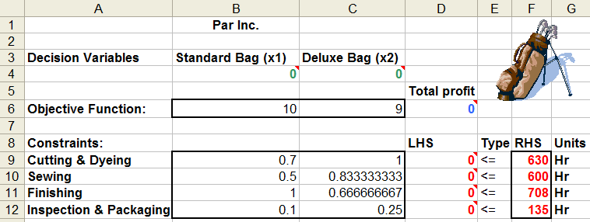
Par, Inc. Problem – Spreadsheet Set Up
Decision variables
B4:C4
Objective function
D6
Constraints
D9:D12
Enter initial values in variable cells B6:C6, B9:C12, F9:F12
Decision variable cells: fill zeros as initial values in B4:C4
Objective function cell:
D6 =
Constraint cells:
D9 =
Copied to D10:D12

Slide 16
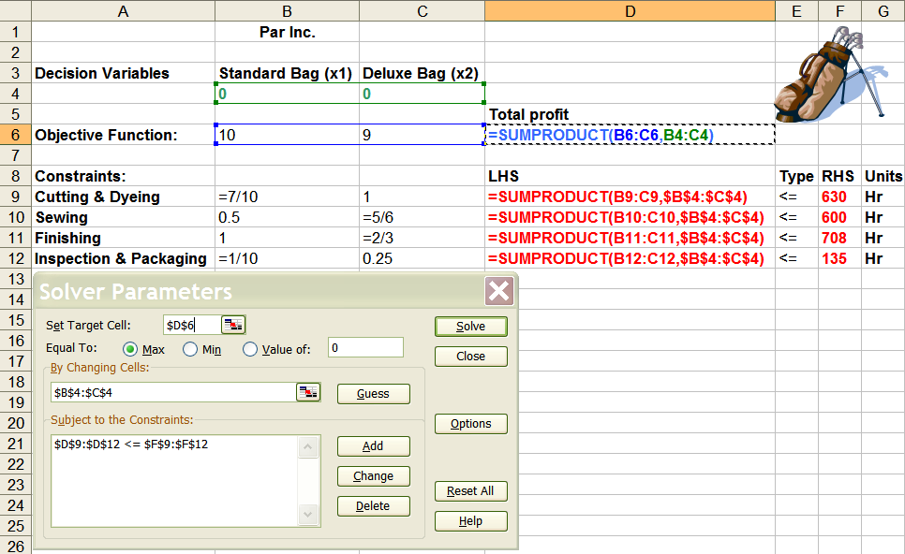
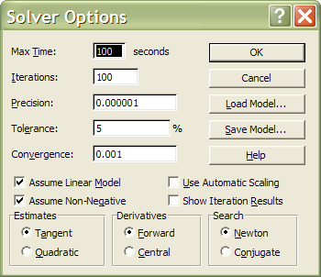
Par, Inc. – Use of Solver [07]
Objective: MAX D6
Variables: B6:C6
Constraints: D9:D12 <= F9:F12
Options: Assume Linear Model
Assume Non-Negative
[07] Data tab -> Analysis
Solver

Slide 17
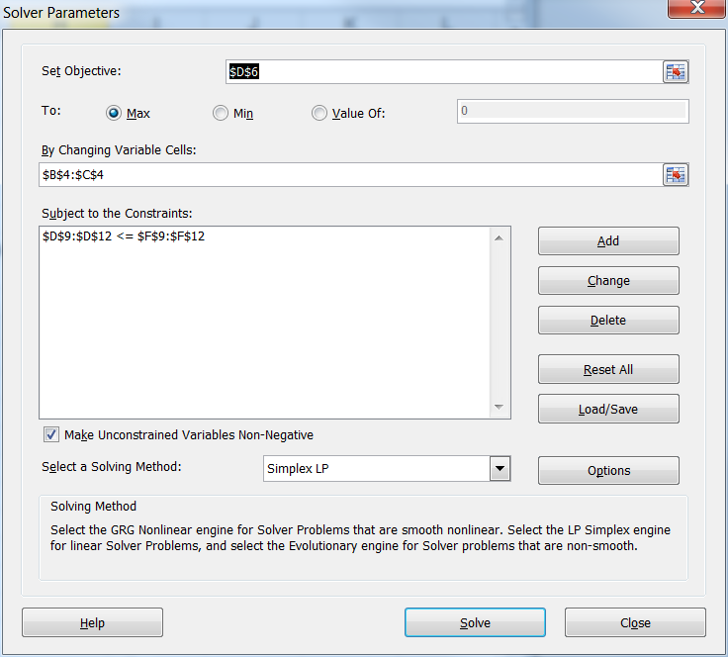
Par, Inc. – Use of Solver [10]

Slide 18
A Simple Blending Example
New Age Pharmaceuticals produces the drug NasaMist from four chemicals. Today the company must produce at least 1000 pounds of the drug. The three active ingredients in NasaMist are A, B, and C. By weight, at least 8% of NasaMist must consist of A, at least 4% of B, and at least 2% of C. The cost per pound of each chemical and the amount of each active ingredient in 1 pound of each chemical are given in the following table. For example, one pound of chemical 1 costs $8 and it contains 0.03 pound of ingredient A, 0.02 pound of ingredient B, and 0.01 pound of ingredient C. It is necessary that at least 100 pounds of chemical 2 be used. Determine the cheapest way of producing today’s batch of NasaMist.

Slide 19
A Simple Blending Example
Data for the Blending Problem
1. What must be decided? What are the decision variables?
x_{i} = lbs of chemical i to include in the mix, i=1,2,3,4
2. What measure should we use to compare alternative sets of decisions?
MINIMIZE total material purchase cost
3. What restrictions limit our choices?
Weight of mix >= 1000 lbs
Chemical 2>= 100 lbs
By weight, A>= 8% of weight of the mix
B >= 4% of weight of the mix
C>= 2% of weight of the mix

Slide 20
Blending Problem Formulation
4. Formulate the objective function:
MIN 8x₁+ 10x₂+ 11x₃+ 14x₄
5. Formulate the constraints:
x₁+ x₂+ x₃+ x₄ >=1000
x₂ >=100
0.03x₁+ 0.06x₂+ 0.10x₃+ 0.12x₄ >=0.08(x₁+ x₂+ x₃+ x₄)
0.02x₁+ 0.04x₂+ 0.03x₃+ 0.09x₄ >=0.04(x₁+ x₂+ x₃+ x₄)
0.01x₁+ 0.01x₂+ 0.04x₃+ 0.04x₄ >=0.02(x₁+ x₂+ x₃+ x₄)
6. Do we need non-negativity constraints?
x_{i} ≥ 0 , i=1,2,3,4
7. Write down the total problem formulation:
MIN 8x₁+ 10x₂+ 11x₃+ 14x₄
s.t.
x₁+ x₂+ x₃+ x₄ >=1000
x₂ >=100
0.03x₁+ 0.06x₂+ 0.10x₃+ 0.12x₄ >=0.08(x₁+ x₂+ x₃+ x₄)
0.02x₁+ 0.04x₂+ 0.03x₃+ 0.09x₄ >=0.04(x₁+ x₂+ x₃+ x₄)
0.01x₁+ 0.01x₂+ 0.04x₃+ 0.04x₄ >=0.02(x₁+ x₂+ x₃+ x₄)
x_{i} ≥ 0 , i=1,2,3,4

Slide 21
Linear Programming Terms
Decision variables
The controllable inputs to the model
Should completely describe the decisions to be made
e.g. In the McDonald’s diet problem: #s of hamburgers, Big Macs, Chicken McNuggets, Garden Salads, and Apple Pies
Objective function
The decision maker wants to maximize (usually revenue or profit) or minimize (usually cost) some function of decision variables. The function to be maximized or minimized is called the objective function.
e.g. In the McDonald’s diet problem: minimize cost (money spent on McDonald’s food)
Constraints
Restrictions placed on a decision variable or a group of decision variables
e.g. In the McDonald’s diet problem: nutrition requirements, i.e., calories, protein, vitamin C, Calcium

Slide 22
Linear Programming Definition
A linear programming (LP) is an optimization problem for which we do the following:
(1) We attempt to maximize/minimize a linear function of a finite number of decision variables.
Linear function: each variable appears in a separate term together with its coefficient
(2) The values of the decision variables must satisfy a finite set of constraints. Each constraint must be a linear equation or a linear inequality.
(3) A sign restriction is associated with each variable. For any variable, x_{i}, the sign restriction specifies that either x_{i} must be nonnegative (x_{i} ≥ 0) or that x_{i} may be unrestricted in sign.
e.g. 2x + 3y, 3.5x, 7.5y
2x + 3y = 10
3x + 4.5y ≤ 100
4x - 3.5y ≥ 50
Is a linear constraint?

Slide 23
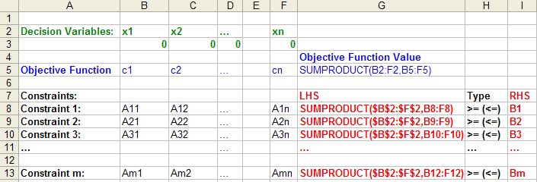
Example
McDonald’s Diet Problem:
MIN 0.69x₁+ 1.99x₂+ 1.99x₃+ 2.05x₄+ 0.79x₅ Linear Objective Function
s.t.
Calories: 260x₁+ 560x₂ + 250x₃+ 35x₄+ 260x₅ ≤ 2000
Protein (in g): 13x₁ +25x₂ + 15x₃ + 2x₄ + 3x₅ ≥ 55 Linear
Vit. C (in %): 2x₁ + 2x₂ + 2x₃ + 40x₄+40x₅ ≥100 Constraints
Calcium (in %): 15x₁+ 25x₂ + 2x₃ + 4x₄+ 2x₅ ≥100
Non-negativity: x₁≥ 0, x₂ ≥ 0, x₃≥ 0, x₄≥ 0, x₅≥ 0 Sign Restriction
General Example:
MAX(MIN) c₁ x₁ + c₂ x₂ + c₃ x₃ + …. +c_{n} x_{n}
ST:
Constraint 1: A₁₁ x₁ + A₁₂ x₂ + A₁₃ x₃ + …. +A_{1n} x_{n} > (≤) B₁
Constraint 2: A₂₁ x₁ + A₂₂ x₂ + A₂₃ x₃ + ….+ A_{2n} x_{n} > (≤) B₂
Constraint 3: A₃₁ x₁ + A₃₂ x₂ + A₃₃ x₃ + …. +A_{3n} x_{n} > (≤) B₃
………
………
Constraint m: A_{m1} x₁ + A_{m2} x₂ + A_{m3} x₃ +…+A_{mn} x_{n} > (≤) B_{m}
x_{i}'s ≥ 0 or unrestricted

Slide 24
Summary
Introduction to Linear Programming
Formulation
Linear objective function
Decision variables
Linear constraints
limitations
requirements
Sign restriction
Solution
Excel solution
Binding, Slack constraints

